Slide 1
Real options: Taking stock and looking ahead
Yong Li, Barclay James, Ravi Madhavan, and Joseph Mahoney
Advances in Strategic Management (2007)

Slide 2
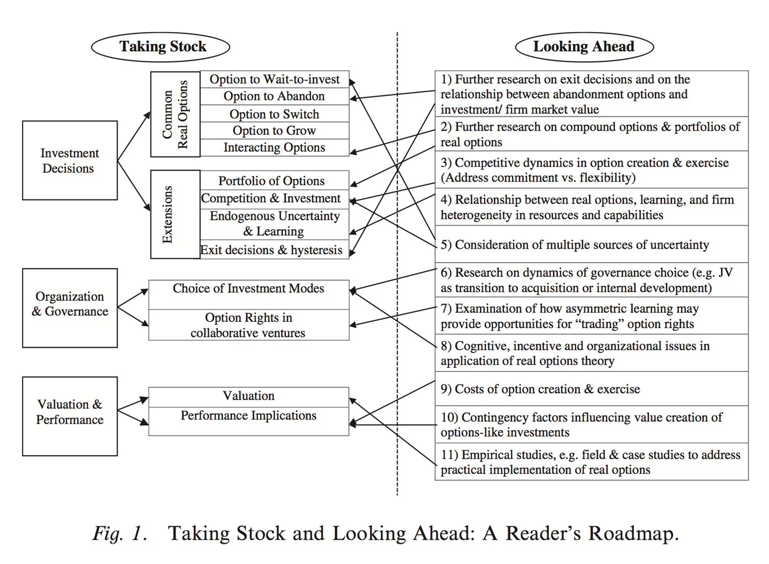
whether and when to invest or exit
How to invest or organize activities

Slide 3
Taking Stock: Applications of Real Options Theory
Common Real Options and Investment Decisions
The option is ‘real’ because the underlying assets are usually physical and human assets rather than financial securities.
Commonalities with financial options:
Rights but not obligations to take some action in the future
Create economic value by generating future decision rights
Provide flexibility when facing uncertainty
Useful in the absence of sufficient information
Differences with traditional investment theory (NPV):
NPV approach fails to consider that managers can adapt and revise its strategies in response to unexpected market and technological developments that cause cash flows to deviate from their original expectations. Traditional investment theory: (1) Investment is now or never; (2) Only invest if NPV is greater than or equal to zero.
Four types of options: Option to Wait-to-Invest; Options to Abandon and Switch; Growth Options; and Interaction of Options

Slide 4
Option to Wait-to-Invest
Common Real Options and Investment Decisions
Provides strategic flexibility to defer the investment until additional information is received with the passage of time
Option is more valuable with high exogenous uncertainty
The time of investing: the present value of the expected cash inflows from a project must exceed the cost of the project by an amount equal to the economic value of keeping the investment option open
Costly ability to wait → growth options
Partial irreversibility → put option of abandonment
Option to Abandon and Switch
“Put Option” gives firms the right to abandon an investment if market conditions get worse or switch when conditions are adverse
Value increases with the salvage value and future uncertainty
As irreversibility increases, put option value is reduced
The positive effect on investment propensity: the threshold value for the optimal decision rule is in general smaller than the full incremental costs.

Slide 5
Growth Option
Common Real Options and Investment Decisions
“Call Option” allows firms to make additional subsequent investments. This can also be understood as a compound option: (1) call: hold asset; (2) put: abandon/switch.
Multi-stage projects: 1st stage: create --- 2nd stage: exercise
Examples: R&D investment →the option to commercialize; joint venture →the option to acquire
Interaction of Options
“Project value”
The incremental value of each additional option is usually not equal to its economic value in isolation
Value is attenuated by “substitute” but enhanced by “complementary” options
Substitute: the option to wait-to-invest vs the option to temporarily shut down
Complementary: the option to expand vs the option to temporarily shut down
Dueling: the option to wait-to-invest and growth options (preemptive effect)
More uncertainty is negatively related to irreversibility.

Slide 6
Extension of Real Options Theory of Investment
Portfolio of Options
Firm decisions as bundles of real options
R&D, alliances, and patenting activities as “creating real options”. Diversification predicts firm investment behavior and strategy: correlated alliances (sub-additive) versus non-correlated.
Competition and investment
Add game-theoretic perspective: competition impacts investment decisions.
Industry structure (perfect competition, oligopoly, monopoly) → first-mover advantage
Endogenous uncertainty and learning
Both types of uncertainty increase the economic value of real options
Exogenous vs endogenous uncertainty: waiting vs learning opportunities
Endogenous uncertainty encourages firms to invest because there is no value to waiting
Exit decisions and hysteresis
Delaying exit may be rational under uncertainty and irreversibility (rational inertia)
Two sides of a coin: Investment may not occur until profits exceed costs by the economic value of the option to invest; similarly, investment may continue until economic losses exceed the value of the option to continue derived from profitable operations in future good states of the world.

Slide 7
Organization and Governance
Preferred investment modes under uncertainty:
When joint venture (collaboration) > acquisition (e.g. vertical integration) or internal development.
When market-like mechanism > integration (strategic flexibility vs strategic commitment)
In collaborative ventures
Option value of acquiring or selling the venture depends on:
Divergent economic valuations of the venture ex ante. Without this, no incentive to sell.
Divergence of ex post valuations
Asymmetric resource complementarity and learning rate. Property rights play a role in determining who gets the put or call option to sell/divest or buy. Badly assigned control rights can lead to predatory and opportunistic behavior by the privileged partner.

Slide 8
Valuation and Performance Implications
Valuation
Real options theory is fundamentally a theory of economic valuation
Takes the value of managerial flexibility into account (e.g. wait-to-invest; switching; abandonment; growth).
Economic value of a firm derives from assets in place + growth options
Performance implications
Technological competence (holding patents) in uncertainty → higher market value
IJVs have positive impacts on growth option values (high uncertainty).
Multinationals have greater flexibility in shifting value chains, compared to domestic-only firms

Slide 9
The Real Options Theory of Investment
Real Options, Learning and Heterogeneity
Different investment patterns based on learning capabilities (Bowman & Hurry, 1993).
Real Options and Game Theory Integration
Real options are usually shared, and their economic value may be eroded by competition. Game theory has outstripped empirical research.
Real Option Theory on Exit/Abandonment Decisions
Inaction (exit delay). More research on abandonment/switching than just growth.
Uncertainty and irreversibility. How this widens or narrows “zone of inaction.”
The interaction between real options or option-like projects
Firms often manage a portfolio of projects simultaneously or sequentially
Effects of Uncertainty
Ambiguity in the sources of uncertainty. These should be spelled out. Robustness checks.

Slide 10
Real Options Studies About Investment Mode Choices and The Performance Implications of Real Options
Options Theory as a complementary approach to Transaction Cost Theory
Contractual issues for uncertain investments. Has added dynamism to TCE: make, buy, partner. How this evolves over time sequences.
Costs of creating and exercising options
Flexibility
RO assumes options have positive value. But cost of attainment matters.
Examine firm- and industry-level influences
Capturing economic value of options depends on firm and industry-specific influences.
Further application
Venture Capital and Entrepreneurship
Clarify mixed empirical results

Slide 11
Issues in Implementation and Questions
Issues
Finding an options pricing model whose assumptions match those of the project being analyzed.
How psychological processes internal to organization delimit real options theory.
Determining the proper measures for the variables
Solving it mathematically.
Promising questions
Given economic incentives problems, psychological biases and organizational processes may effect option creation:
Who controls the decision rights to the option?
What changes in the firm’s processes are needed to manage real options?
What changes in the organization are needed to capture the option value?

